Slide 1
My PhoneBook
Matej Miholjek
Mobilne aplikacije

Slide 2
API’s
Goggle Sign In
Link: https://developers.google.com/identity/sign-in/web/sign-in
UniNames
Link: https://uinames.com/

Slide 3
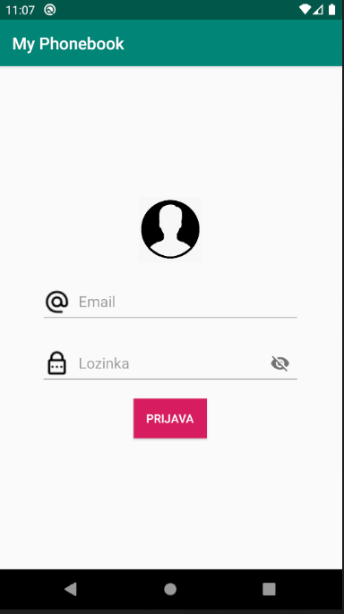
Login Page

Slide 4
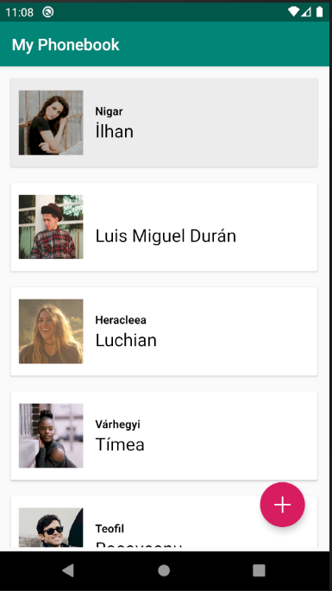
Main Menu

Slide 5
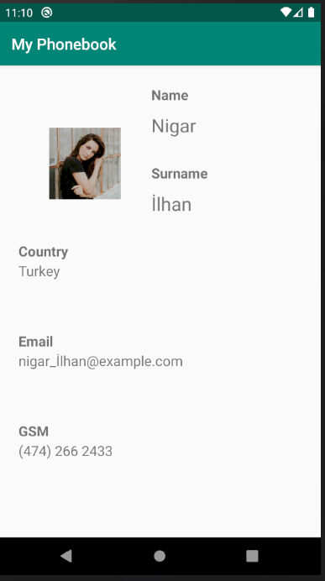
Details View

Slide 6
Hvala na pažnji!

